Slide 1
Osoc Task
By Deepak suda

Slide 2
Title of Game
The Maze Runner

Slide 3
Contents
Game and overview
Objectives
Stage of game
Feature
User interfaces

Slide 4
Overview
The game name will be The Maze Runner.
In Maze runner , the player will be into a maze.
The game start from the entering point of maze and the player have to reach the exit point.
In multiplayer the first one reach the last position win the game.

Slide 5
Objective
This game is for the event “ Technofania” conduct by OSOC club .
It’s objective is to entertain community and make them enthusiast about game development.

Slide 6
Stage of Game
Exit
Reach to end
Find way to exit
Start

Slide 7
Tools Requirement and description
Features
It will be client server game (multiplayer )
We provide movements to the player.(left , right and jump to clear some obstacles.
There will be a timer that will indicate the score.
Reaching to exit gate will complete the game.

Slide 8
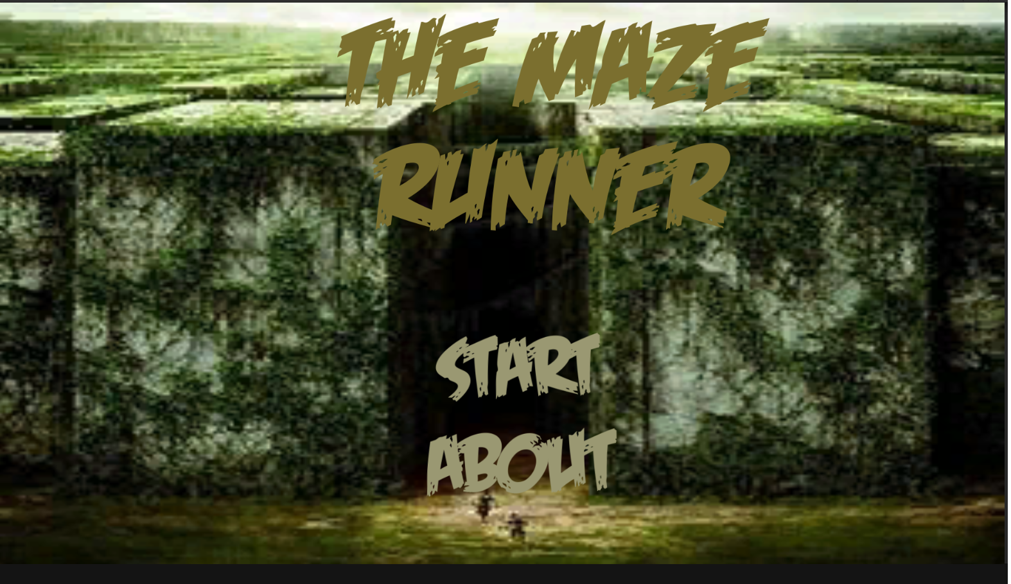
User interface

Slide 9
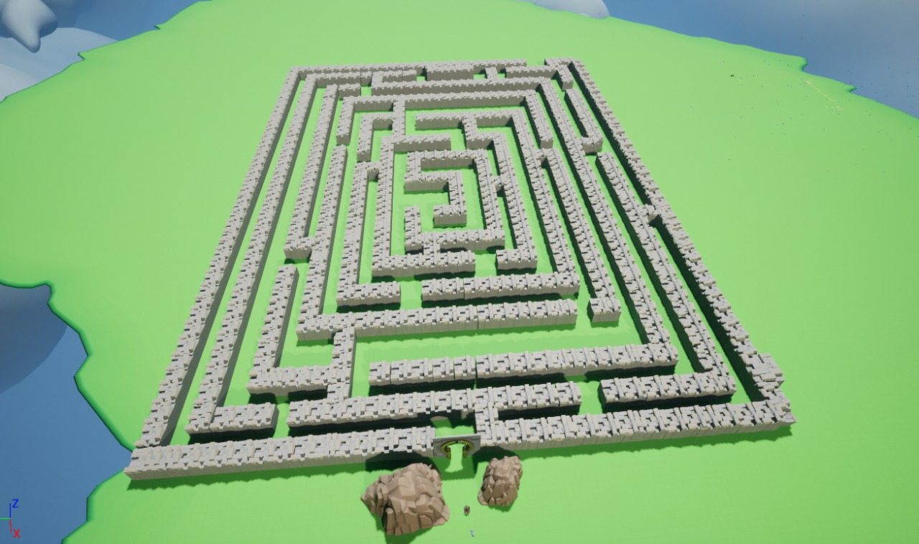
User interface 2

Slide 10
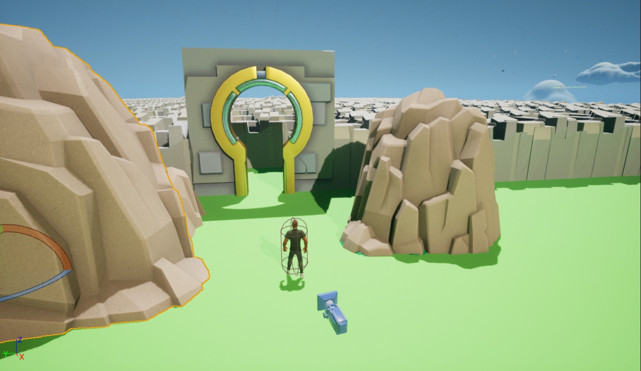
User interface 3

Slide 11
Functionality
Run the game
Get instruction
Start the game
Move left and right
Find the way to the end
Get minimum time
Reach the end
Play again or quit the game

Slide 12
Thank You

